Slide 1
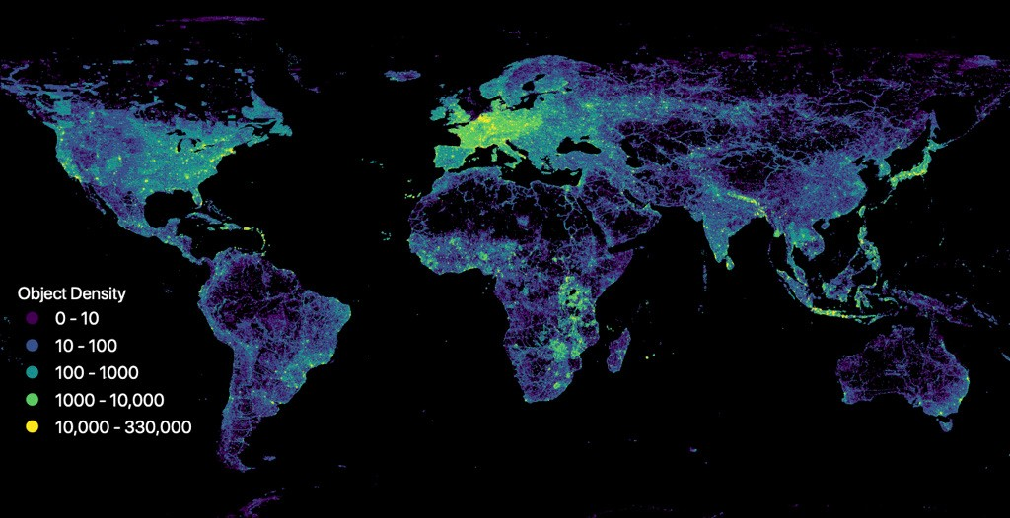


Missing Maps
@theMissingMaps
Notes:
Welcome! This is a data density map of nodes in OSM - Open Street Map (which we will get to later). What this image tells us is that many of the world’s vulnerable communities are NOT on any map. This is a problem for organizations in the humanitarian relief and disaster response space.

Slide 2
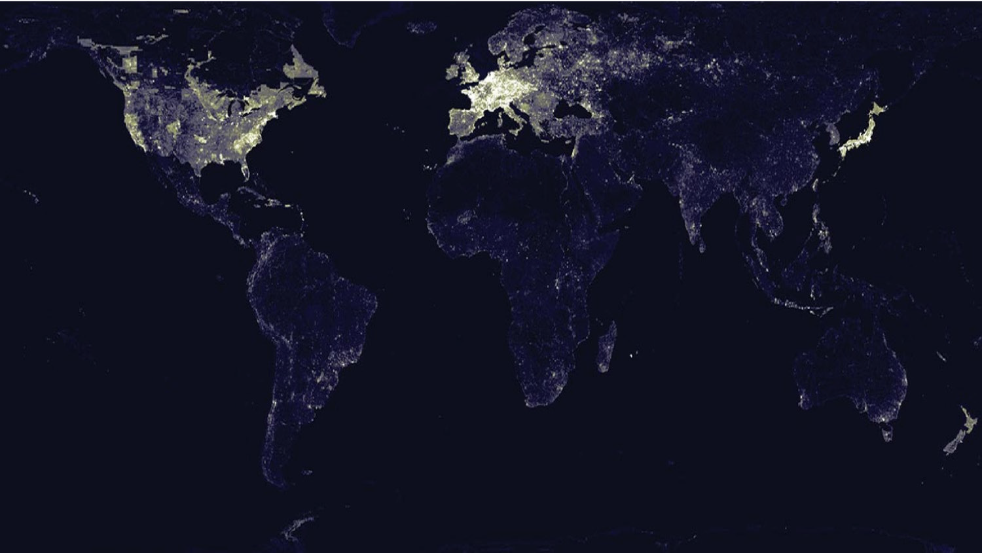
Background and context
Back in 2014...
Notes:
When we don’t know where people live, where they shop, where they cross borders, we can not help them as effectively as possible, let alone plan preventative programming. So in 2014 we formed the Missing Maps partnership to address these gaps.

Slide 3
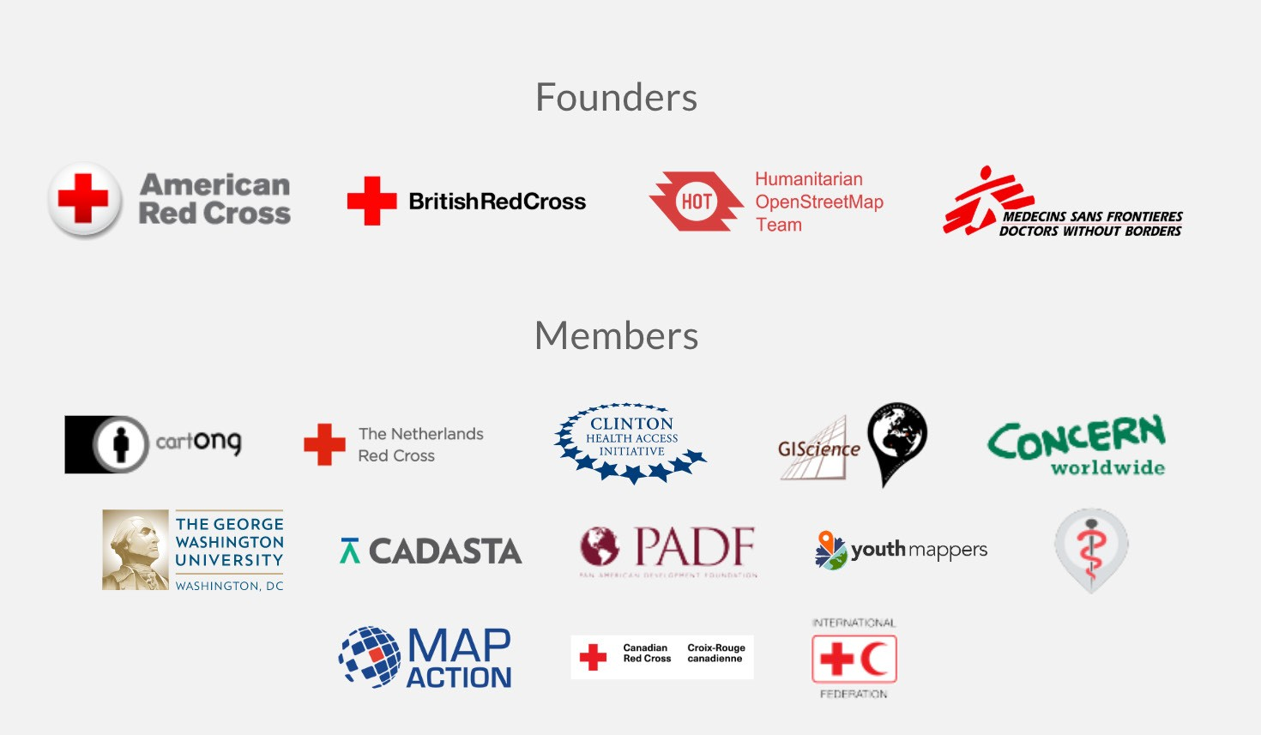
Background and context
Notes:
The project aim was to strategically map the worlds vulnerable communities. Since it’s unprecedented founding, the Missing Maps partnership has grown to include new partners like Map Action and the university focused Youth Mappers organization. In 2020, our newest group, the German Red Cross will join.

Slide 4
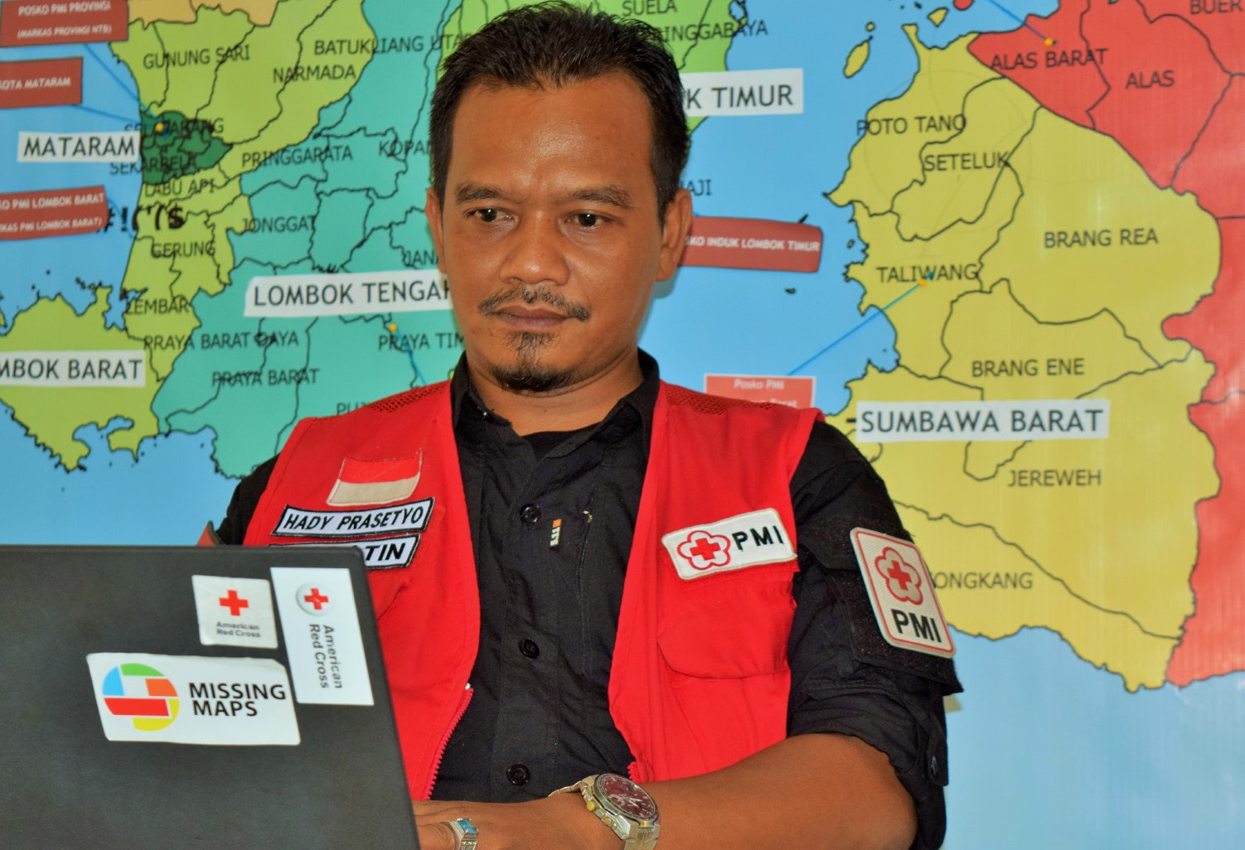
Background and context
Notes:
We’ve come a long way in the last 5 years! As the program gained momentum, OSM and the Missing Maps workflow has become an industry standard across the Red Cross Movement. After the Indonesia Earthquake in 2018, Hady Prasetyo created dozens of new maps to plot earthquake damage, affected households, and delivery of humanitarian aid in Lombok using this open-data. “Creating maps helps humanity” said Hady.

Slide 5
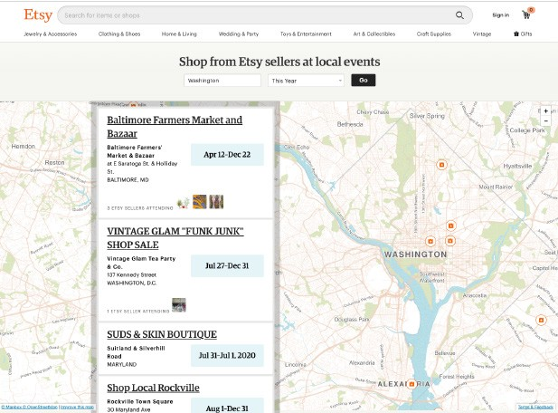

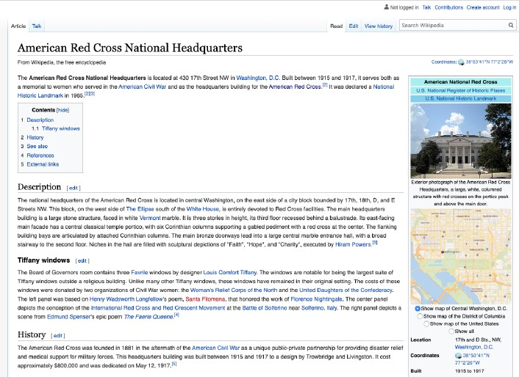
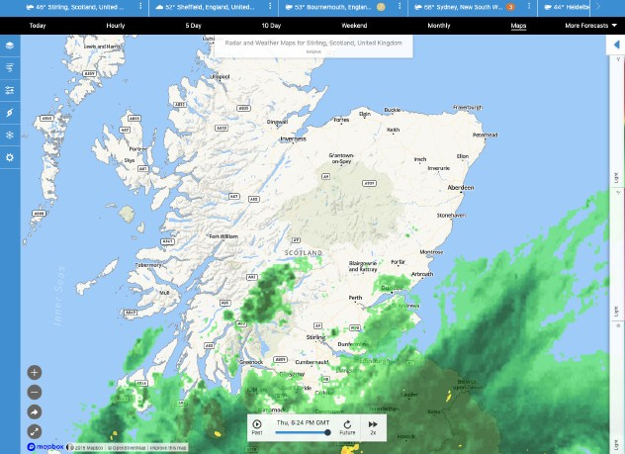
Background and context
Notes:
How many of you are familiar with OSM? Basically it’s the Wikipedia of maps. It is open source and editable by anyone. OSM isn’t just a humanitarian tool, you might be using it in your daily life already! If you’ve used etsy, Wikipedia, the weather channel, or watched the Patriot Act, you’ve used OSM data already!
OSM is 1 MILLION mappers strong, so keep in mind that whatever you map today (both at home and globally) will probably be used for multiple resources! A great example of this is Map.me, a navigation app that many hikers use all over the world. So please remember that while we have a validation component for Missing Maps, that data will be used for multiple other projects so mapping respectfully from the stat is key!

Slide 6
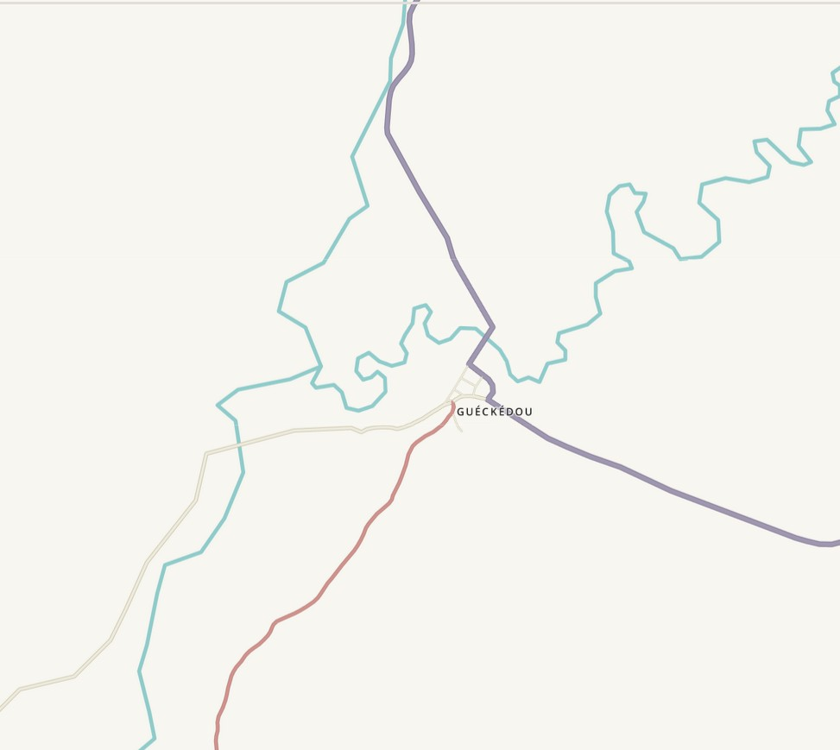
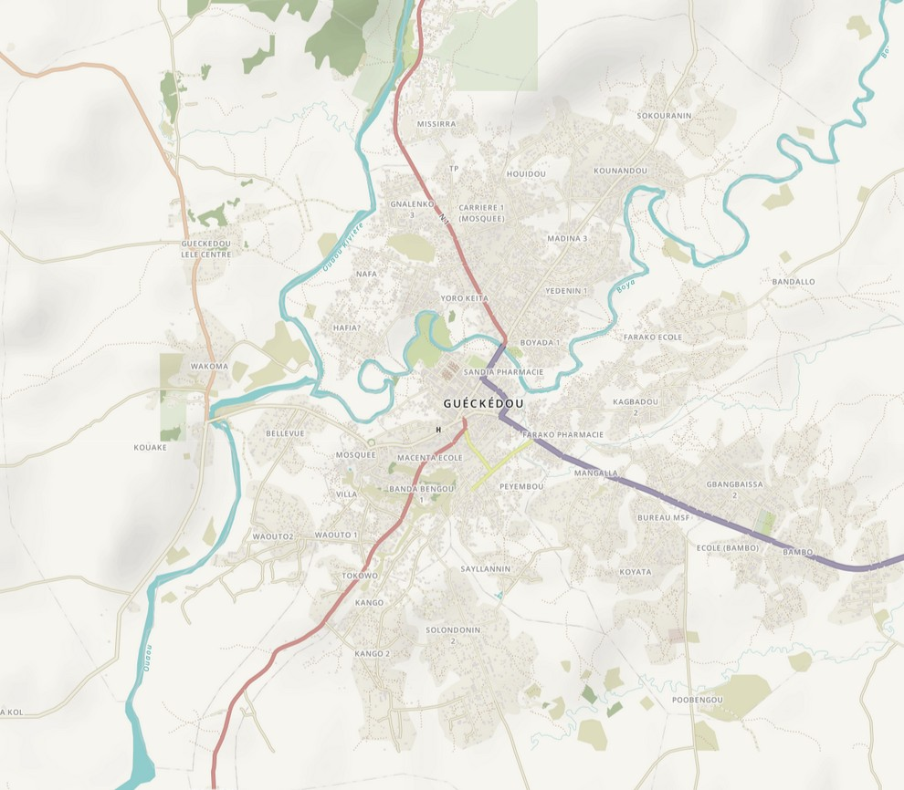
Background and context
Before remote mapping
After remote mapping
Notes:
SO, why are some of the communities we work with missing from the map? Often, communities we set out to document are well established, but for profit-companies haven’t prioritized documenting them. A community could also be documented, but using a proprietary system. This makes it hard and expensive for decision makers to access data for their own communities.
Image: Before and after for Gueckedou, Guinea. The Red Cross had a mapping hub here as part of our post-Ebola recovery work in 2016.

Slide 7
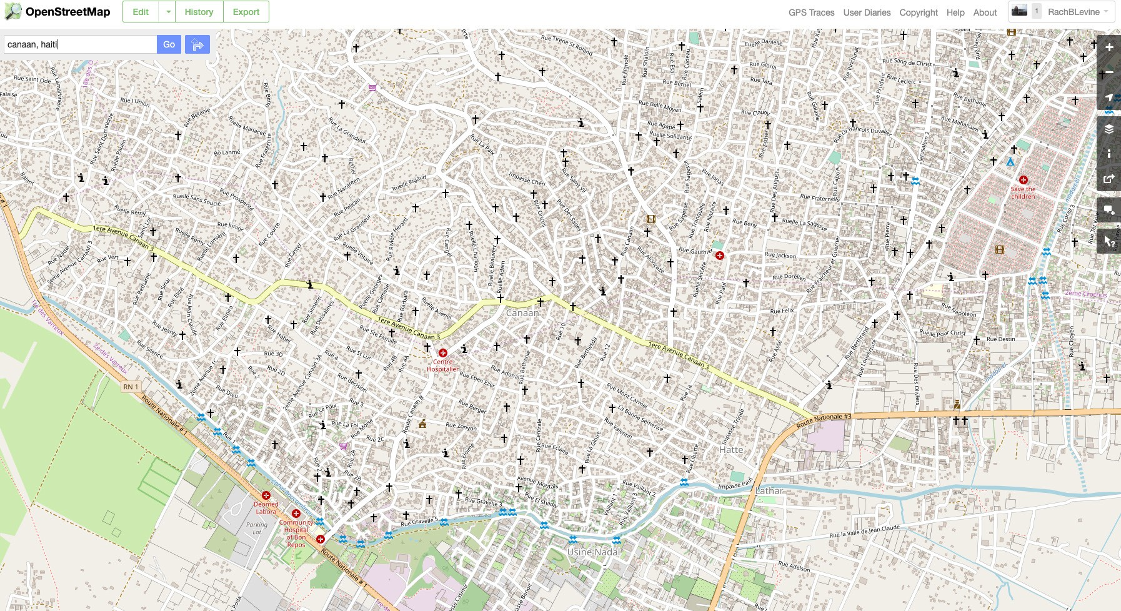
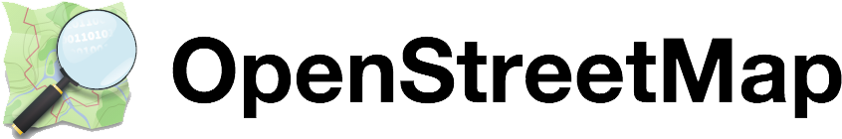
Background and context
Notes:
Another reason communities need documentation is because they are new or have experienced significant changes. Since the Haiti earthquake in 2010, almost a quarter-million people have moved to the hillsides surrounding Port-au-Prince. Here we can see one of those communities, Cannan.

Slide 8
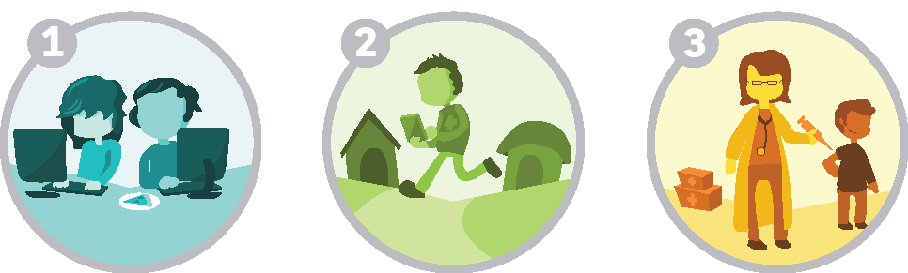
Background and context
Missing Maps
Step 1
Volunteers trace satellite imagery into OpenStreetMap
Step 2
Community volunteers add local details such as neighborhoods, street names, and schools
Step 3
Humanitarian organizations use mapped information to plan activities that save lives
Notes:
Missing Maps is a preparedness program. We create data for communities to support specific projects and to meet future data-needs. This long-term data-readiness activity is ongoing and building out the map is a continuous process to address vulnerabilities in partnership with National Societies. Mapping might take place over a couple months, or a couple years, and these needs and vulnerabilities will change with time.
For mapping that is tied to projects, we have a three step process. Let’s take a closer look at each step…

Slide 9
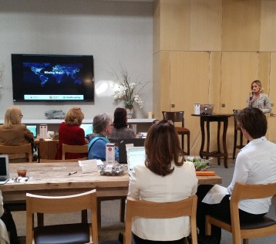
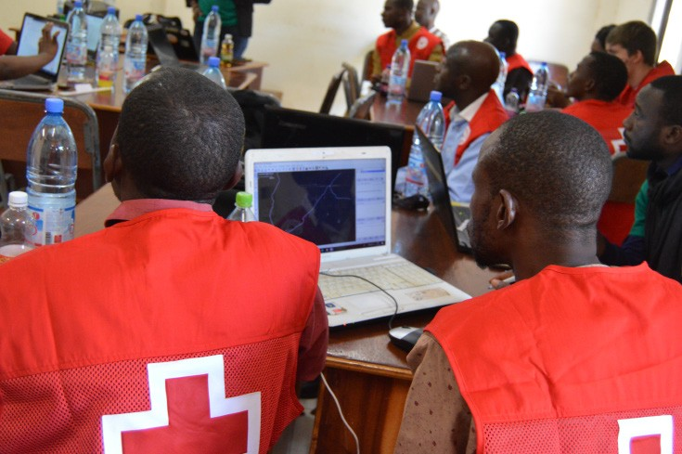
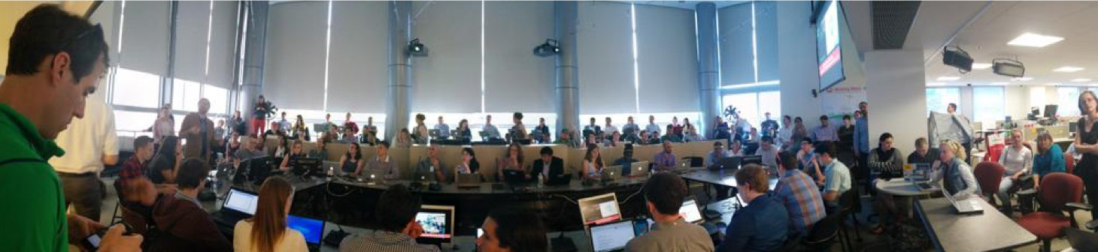
Remote mapping
1
Notes:
First, digital volunteers trace satellite imagery to create base map. While you can do this on your own, tracing also happens at events we call Mapathons. These events are happening all over the world – in public libraries, college campuses, and the workplace. The mapathons result in the creation of, a basic, digital map. We consider this the black and white phase of the map.
Image 1: Milan Red Cross Geoweek 2019 Mapathon
Image 2: Tennessee Red Cross Tiffany Circle Mapapthon 2017
Image 3: American Red Cross NHQ - 2014

Slide 10
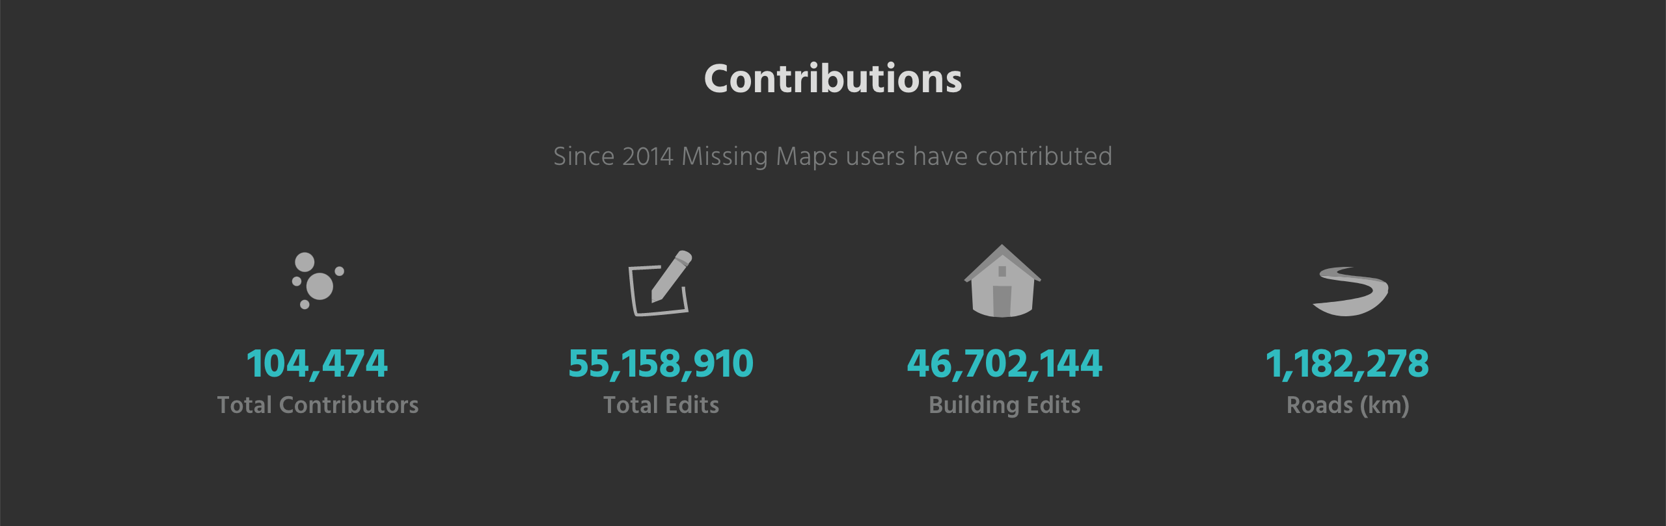
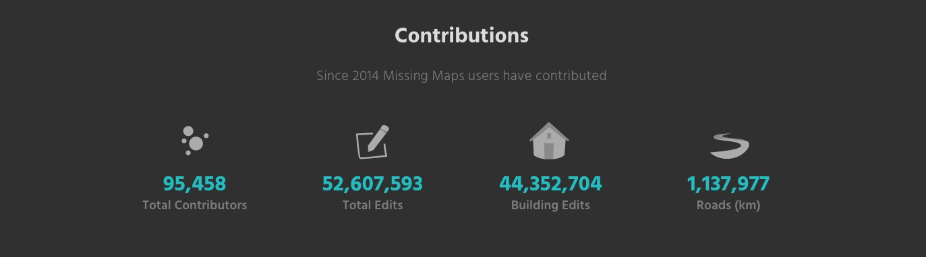
Remote mapping
1
Notes:
So welcome to the club! We’ve had about 104,000 volunteers for the program at this point putting 46 million buildings on the map!

Slide 11
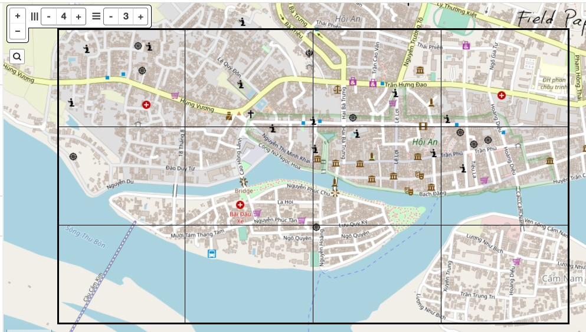
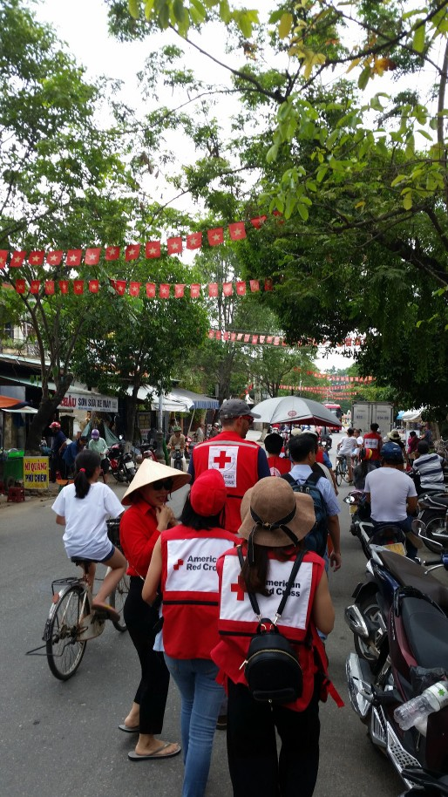
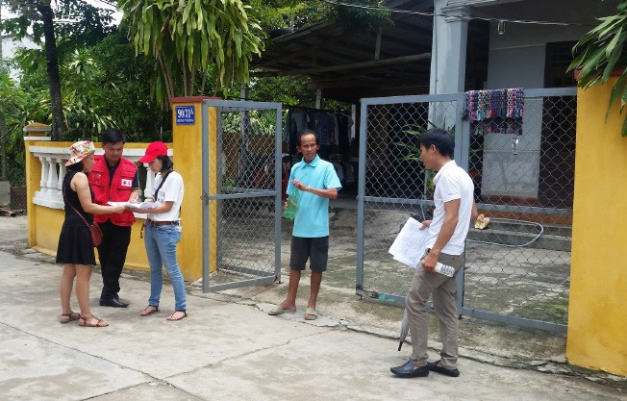
Field mapping
2
Notes:
Onto Step 2! After creating a base map, community members or those with local knowledge fill in the map. Local communities decide what is important for them and mapping begins. We organize our work by gridding out a community and assigning squares. This set up is quite similar to what you’ll be doing later!
When mapping a community we are talking about 3 ideas: Accessible, Respectful, and Comprehensive. Accessible maps are those that the community can update and grow with. When something lives in a government ministers file cabinet, or is a PDF, we can’t update it with the community. Respectful mappings comes in not just in how neatly we trace features in a community, but in naming conventions as well. As communities change and honor different administrations or local heroes for example, accessible maps can be updated quickly to reflect these new naming conventions. Last, but not least, comprehensive maps. When a community leader can see the full picture, they can make more informed decisions. Mappers can contribute on their own, and projects might span multiple mapathons, so it’s common for squares to have features in them already. When this happens, please check over your square and make sure nothing is missed before marking as finished. On the flip side, it’s important to know where people aren’t! We often need information for remote areas, so if your square is sparsely populated, please give it a good look over and then mark ask finished.
Top Image: FieldPapers for Hoi An, Vietnam.
Right Image: Mappers head out to find their square.
Bottom Image: Mappers ask a community member for more information.

Slide 12
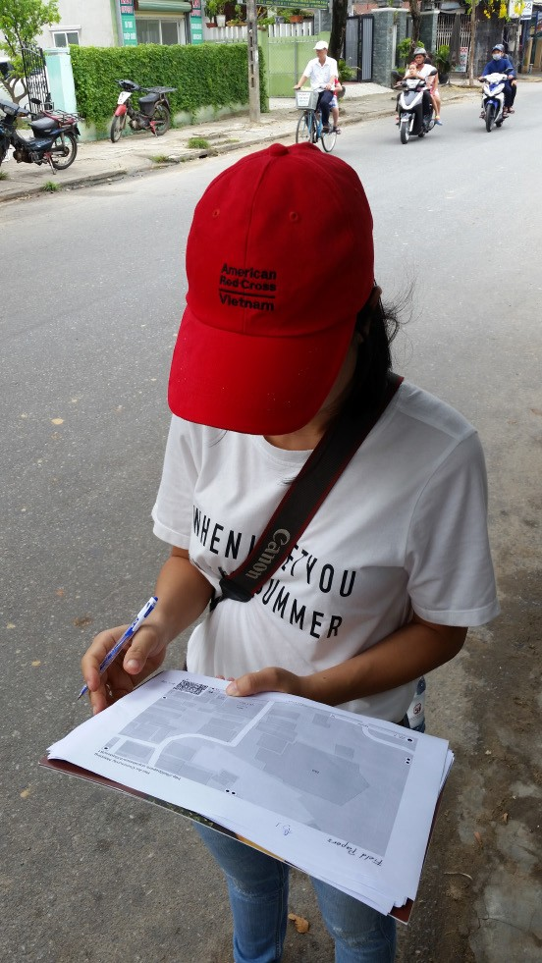
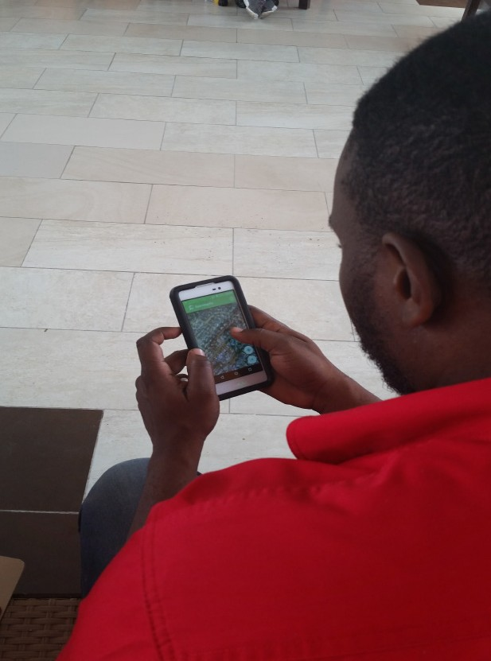
Field mapping
2
Notes:
Mappers collect their data differently depending on the needs and capacity of the community. We mostly use mobile phones (on the left, at a mapping training w/ the Jamaican Red Cross) to paper resources (on the right, in Vietnam).

Slide 13
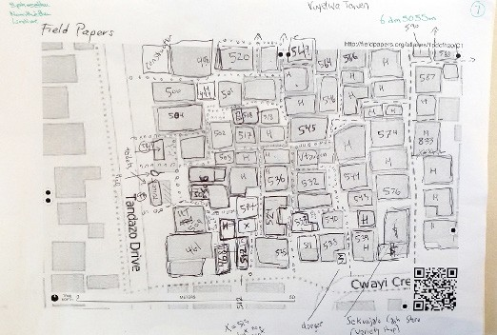
Field mapping
2
Notes:
Note: This slide can be used for train-the-trainers or when you want to dive a bit deeper into what successful remote-mapping looks like. Note that the original mapper has made a couple of mistakes, but that overall it’s very neat and comprehensive. Make sure to point out the even shapes that were traced.

Slide 14
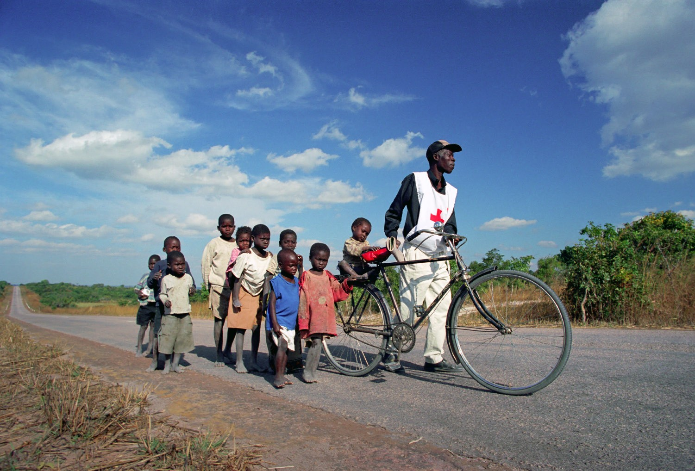
Outputs
3
Notes:
Onto step 3: Using the data!
Launched in February 2001, the Measles Initiative is a long-term commitment to prevent deaths by vaccinating children in partnership with local ministries of health, the United Nations Foundation, WHO, and UNICEF. One in every 500 people around the world is either a Red Cross staffer or volunteer, that means one thing we do better than most any other organization is social mobilization. Here in Zambia, a trusted Red Cross volunteer Anton collects local children who need to be vaccinated. He picks them up w/ his bike, takes them to the clinic, and returns them to their parents. When we have maps to guide volunteers like Anton, we can make sure no children are missed.
In 2017, we added 1 million buildings to help prepare for a Measles vaccine campaign in Malawi. Because measles vaccination rates need to hit 95% for herd immunity to protect the most vulnerable, mappers all over the world prepared this data to assist with the vaccination of 8 million children in only one week!
Most recently we worked with the Measles and Rubella Initiative (MRI) team in Kenya to help plan out their M&E. MM data was used to better understand population distribution to improve routine immunization in 5 Point Plan.

Slide 15
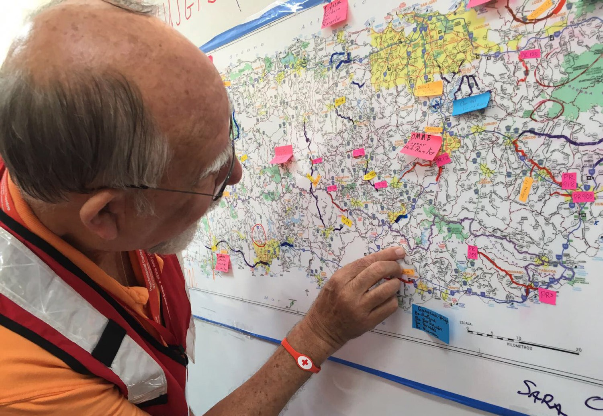
Outputs
3
Notes:
We also work here in the US! Another great example of our maps in action was our work in Puerto Rico following Hurricane Maria in 2017. Over 6,000 people helped us produce the most comprehensive maps of the island in the 3 weeks after landfall. In addition to supporting navigation needs, we partnered with our Restoring Family Links program, and were able to compare these maps to places with no connectivity and set up charging and wifi stations for people use to contact their loved ones.

Slide 16
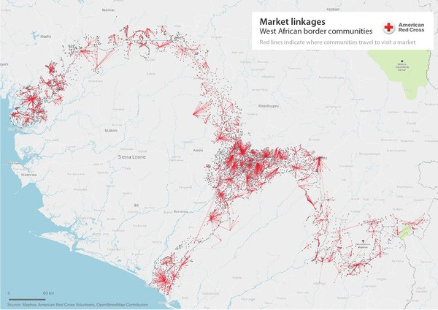
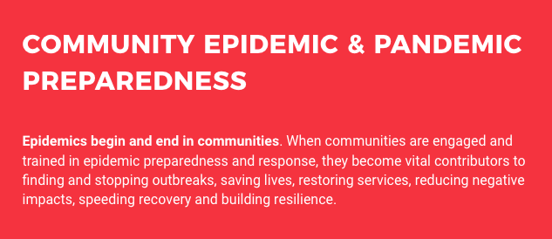
Outputs
3
Notes:
Often when pandemics occur, contract tracing is an important step in stopping it’s spread. The largest Ebola outbreak lasted from 2014-2016. One of the reasons it lasted so long was the inability to contract trace most patients who arrived at MSF clinics. Only about 2 out of ever 10 were able to be traced. What we noticed is that many of these people came from areas in the border regions. So after the outbreak we set out to map and name these communities. We had originally thought we’d visit 5,000 some communities, but it ends up there were 7,000+!
Knowing what people call the place where they live is a key building block towards understanding a community. This concept, documenting communities before an epidemic strikes, is the core of our work with the CP3 program. CP3 – the Community Epidemic and Pandemic Preparedness Program, is organized by the IFRC and we’ve spent the last 2 years working directly with 8 National Societies to build out their maps and assist with data gathering. When we know where what a community calls themselves, where hospitals are, or the fastest way to get from Town A to B we are better prepared for whatever comes our way.

Slide 17
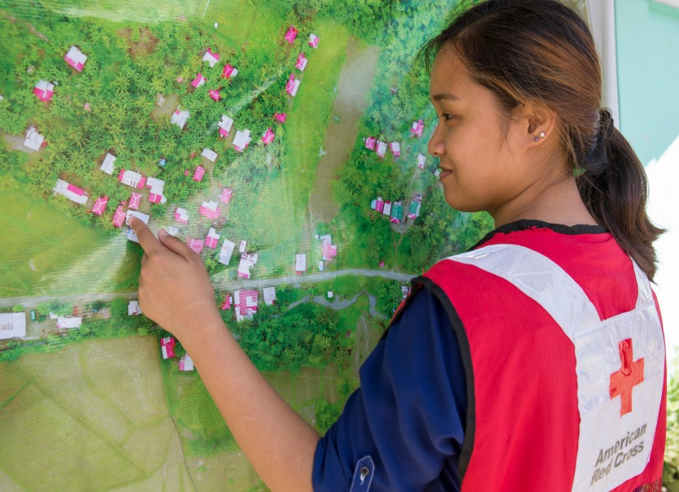
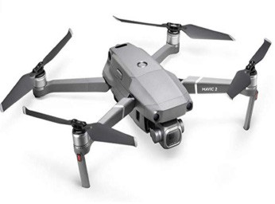
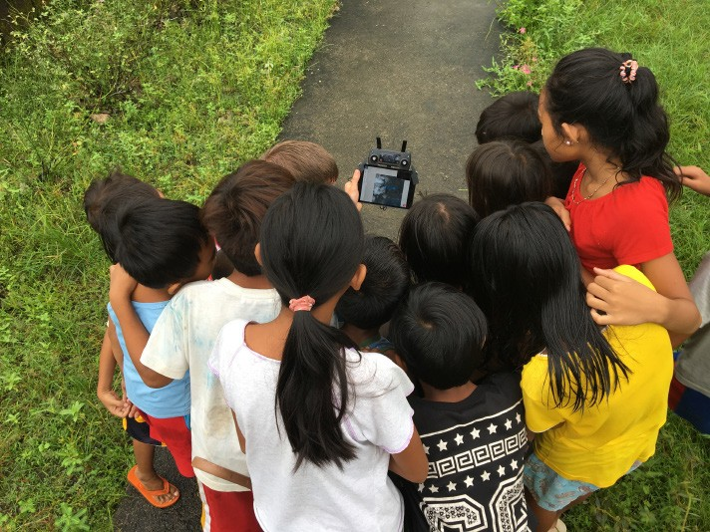
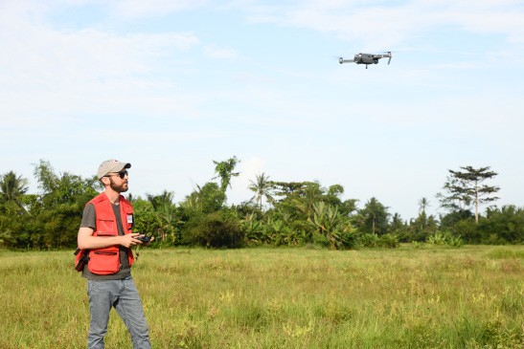
Outputs
3
Notes:
Going forward, we are very excited about the work we’ve been doing with drones. In the past we’ve used drone imagery to document the new community of Cannan, Haiti and the recovery efforts in Tacloban following Typhoon Haiyan in the Philippines. In these images, we are flying drone imagery and will use the maps produced to keep track of shelters built with Red Cross support. You’ll see those are the ones with red roofs. This data isn’t just used once. Everything we process is shared back with the community and the wider world using OpenDroneMap. You’ll see the next step for this data in the image on the right. This turned into a map that now hangs outside of Town Hall and is used to verify evacuation routes, respond to disasters and ensure that every household is cared for in case of an emergency.

Slide 18
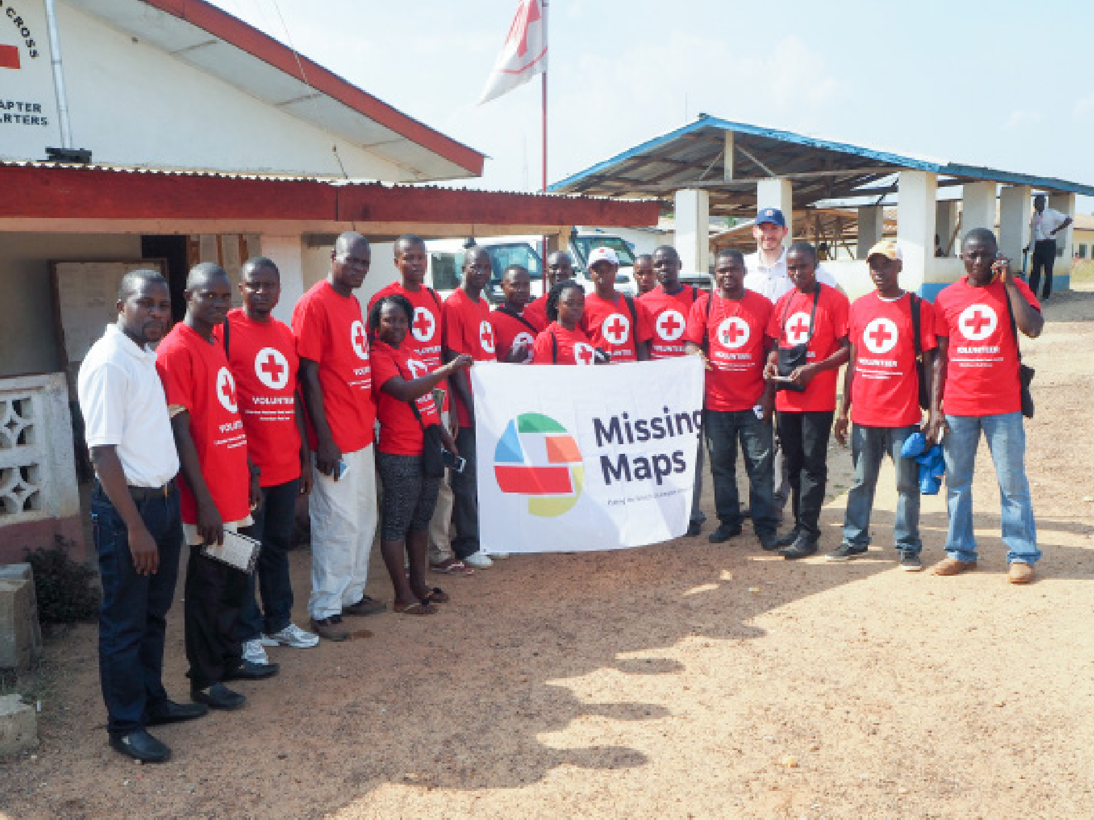
3
Outputs
2017: We mapped the communities of 20 million people
Notes:
When the partnership first formed, our goal was to map the communities of 20 million people. We reached that in about 18 months!

Slide 19
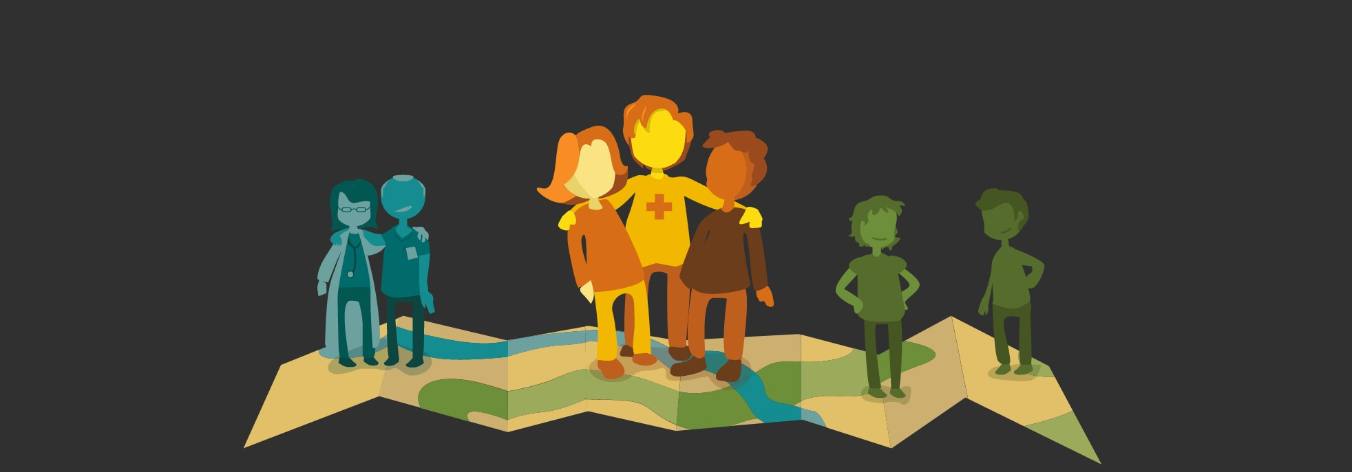
3
Outputs
And the communities of 200 milllion people by 2019!
Notes:
Our next goal was to map 200 million people. We hit that in Nov 2019, a year early! That’s thanks to mappers like you.

Slide 20
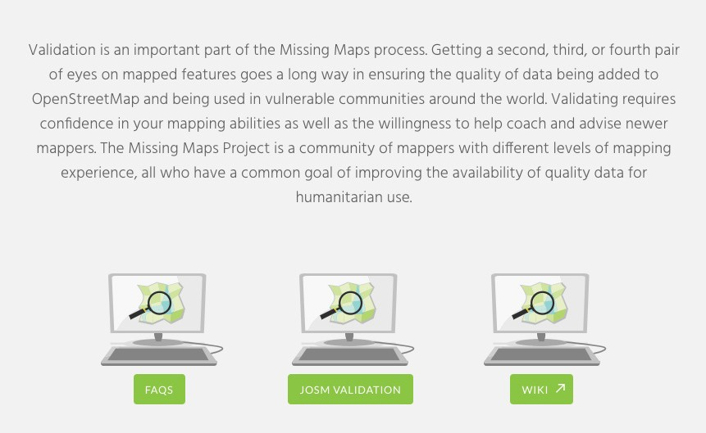
Future directions
Notes:
Going forward, our big goal is to validate all that data, continue to support communities as they keep that data up to date and of course, keep mapping!
AI (artificial intelligence) and ML (machine learning) are both new technologies that will help us with this process.

Slide 21
Create User ID
www.openstreetmap.org/user/new

Slide 22
Find a Project
Start Mapping
www.missingmaps.org/partners/microsoft

Slide 23
Stay Engaged
with Your Red Cross
DONATE TAKE A CLASS
GIVE BLOOD VOLUNTEER
Notes:
Staying engaged with your American Red Cross
Donate
With a single donation, you can make a difference in your neighborhood and in communities around the world. The Red Cross is not a government agency; we need financial support to do our work. We rely on the generosity and willingness of businesses and individuals to help others in need and take great pride that 91 cents of every dollar we raise is invested in humanitarian services. To help, donate through the Microsoft Give Campaign and make every dollar go twice as far with Microsoft’s matching gift program.
Take a Class
Take a class and know exactly what to do in an emergency. Red Cross classes help to save lives and empower people to respond to life-threatening emergencies – from drowning to heart attacks. Millions of people each year gain lifesaving skills – including first aid, CPR and the use of defibrillators – through their local Red Cross chapters. To find out more, visit redcross.org and click on “Training & Certification” on the top of the page.
Give Blood
Every two seconds, someone in the US needs blood for medical emergencies or lifesaving treatment of chronic illnesses. More than 38,000 blood donations are needed daily and just one pint of blood can save as many as three lives. If you are interested in giving blood or hosting a blood drive, please visit redcrossblood.org.
Volunteer
Make an impact in someone’s life. Nearly 500,000 people give their time to make their neighbors safer by volunteering through the Red Cross. We train volunteers and empower communities with the skills they need to help themselves. Red Cross chapters nationwide need trained volunteers who can be mobilized when disaster strikes. Visit redcross.org/volunteer to find volunteer opportunities in your area.

Slide 24




redcross.org/what-we-do/international-services
missingmaps.org
@theMissingMaps
facebook.com/MissingMapsProject
Notes:
Learn more, Keep in touch, and share your contributions - Thank you!

